Slide 1
zekeLabs
Learning made Simpler ! www.zekeLabs.com

Slide 2
Docker Enterprise Edition: Best Practices

Slide 3
Docker EE
The Docker EE platform is responsible for container-level operations, interaction with the OS, providing the Docker API, and running the Swarm cluster.
The Engine is also the integration point for infrastructure, including the OS resources, networking, and storage.

Slide 4
Universal Control Plane
UCP extends Docker EE Basic by providing an integrated application management platform.
It is both the main interaction point for users and the integration point for applications.

Slide 5
Universal Control Plane
UCP runs an agent on all nodes in the cluster to monitor them and a set of services on the controller nodes.
This includes identity services to manage users, Certificate Authorities (CA) for user and cluster PKI, the main controller providing the Web UI and API, data stores for UCP state, and a Classic Swarm service for backward compatibility.

Slide 6
Docker Trusted Registry
The DTR is an application managed by, and integrated with UCP, that provides Docker images distribution and security services.
The DTR uses UCP's identity services to provide Single Sign-On (SSO), and establish a mutual trust to integrate with its PKI.
It runs as a set of services on one or several replicas: the registry to store and distribute images, an image signing service, a Web UI, an API, and data stores for image metadata and DTR state.

Slide 7
Swarm Mode
To provide a seamless cluster based on a number of nodes, DDC relies on Docker swarm mode capability.
Swarm mode divides nodes between workers, nodes running application workloads defined as services, and managers, nodes in charge of maintaining desired state, managing the cluster's internal PKI, and providing an API.
The Swarm mode service model provides a declarative desired state for workloads, scalable to a number of tasks, accessible through a stable resolvable name, and optionally exposing an end-point.

Slide 8
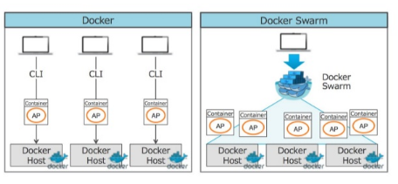
Docker vs Docker Swarm

Slide 9
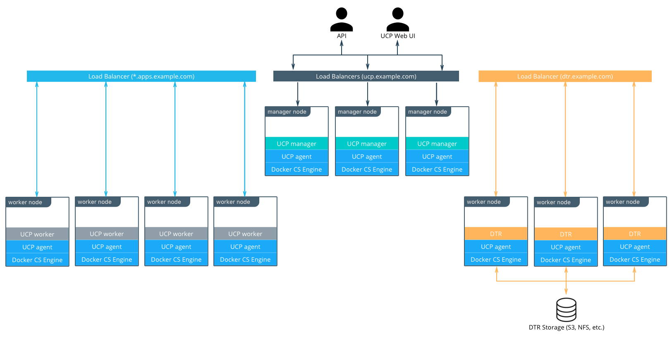
Standard Deployment Architecture

Slide 10
Node Type
A node is a machine in the cluster with Docker Engine running on it.
When provisioning each node, assign it a role: UCP Controller, DTR, or worker node so that they are protected from running application workloads.

Slide 11
Node Size
To decide what size the node should be in terms of CPU, RAM, and storage resources, consider the following:
All nodes should at least fulfill the minimal requirements for UCP 2.2: 2 GB of RAM and 3 GB of storage.
UCP Controller nodes should be provided with more than the minimal requirements but won't need much more if nothing else runs on them.
Ideal Worker nodes size will vary based on your workloads
Other considerations like target density (average number of container per node), whether one standard node type or several are preferred, and other operational considerations might also influence sizing.

Slide 12
Load Balancers
Load balancers configuration should be done before installation, including the creation of DNS entries.
Most load balancers should work with Docker EE.
The only requirements are TCP passthrough and the ability to do health checks on an HTTPS endpoint.

Slide 13
DTR Storage
The DTR usually needs to store a large number of images.
It uses external storage (S3, NFS, etc.), not node storage so that it can be shared between DTR replicas.
The DTR replicates metadata and configuration information between replicas, but not image layers themselves.

Slide 14
Recommendations for Docker EE Installation
The three main stages of a Docker EE Standard or Advanced installation
Deploying and configuring the infrastructure (hosts, network, storage)
Installing and configuring the Docker Engine, running as an application on the hosts
Installing and configuring UCP and the DTR, delivered as containers running on the Engine

Slide 15
Infrastructure Considerations
Network
Firewall
Load Balancers
Shared Storage
Host Configuration
Clock synchronization
Static IPs
Hostnames
Host firewalls.
Storage

Slide 16
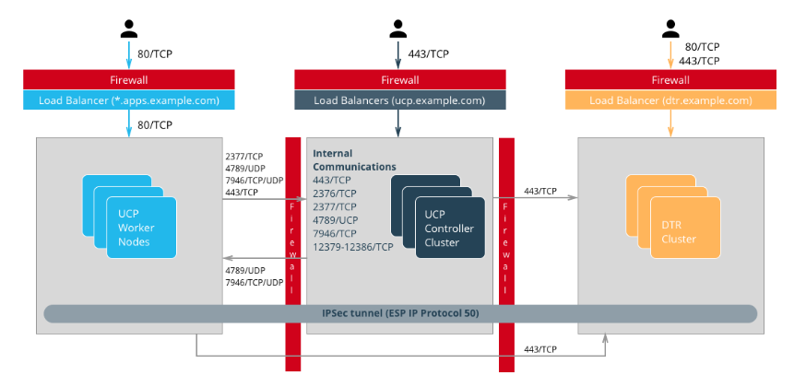
Infrastructure Considerations

Slide 17
UCP Installation Considerations
External Certificates
By default UCP uses self-signed TLS certificates. For production deployments, it is recommended to use certificates generated by a trusted CA
License File
The license file can be provided for installation via the command line as well using a bind-mount (volume) in /config.
.

Slide 18
UCP Installation Considerations
Admin Password
To make the installation entirely non-interactive, the admin password must be passed using the --admin-password install parameter.
Adding Nodes
UCP configures a full controller replica on the manager node in the cluster, so the only command needed on the two controllers is a docker swarm join
.

Slide 19
High Availability in Docker EE
Swarm
To provide a seamless cluster based on a number of nodes, DDC relies on Docker swarm mode capability.
UCP
UCP runs a global service across all cluster nodes called ucp-agent. This agent installs a UCP controller on all Swarm manager nodes.
DTR
It has one replicated component, its datastore, which might also have a lot of state to replicate at one time.

Slide 20
High Availability in Docker EE
Backup and Restore
The HA setup using multiple nodes works well to provide continuous availability in the case of temporary failure, including planned node downtime for maintenance.
UCP Backup
UCP backup is done using the docker/ucp backup command on a controller node. It stops the UCP containers on the node and perform a full backup of the configuration and state of UCP.
DTR Backup
A DTR backup includes configuration information, images metadata, and certificates. Images themselves need to be backed up separately directly from storage.

Slide 21
Identity Management
Accessing resources (images, containers, volumes, networks etc) and functionality within the components of Docker EE (UCP & DTR) require an account and a password to be accessed.
Accounts within Docker EE are identities stored within an internal database,
Source of creating those accounts and the associated access control can be manual or through LDAP or Active Directory

Slide 22
RBAC and Managing Access to Resources
UCP provides powerful role based access control features
The default roles in UCP are:
None,
View Only,
Restricted Control,
Scheduler,
Full Control.
Additional custom roles can be defined by combining a unique set of permissions.

Slide 23
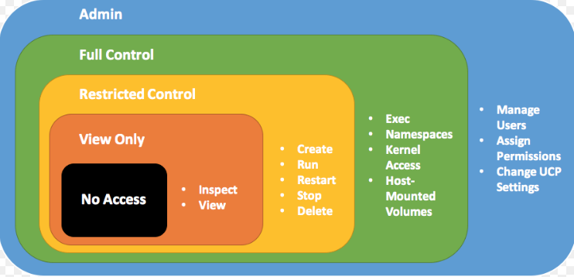
RBAC Example Use Case

Slide 24
Managed (Internal) Authentication
User management using the "Managed" mode is recommended only for demo purposes or where the number of users needing to access Docker EE is very small.
Pros:
Easy and quick to setup
Simple to troubleshoot
Appropriate for a small set of users with static roles
Managed without leaving the UCP interface

Slide 25
LDAP / AD Integration
The LDAP method of user account authentication can be turned on to manage user access.
Enables automatic synchronization of user accounts from a directory server such as Active Directory or OpenLDAP.
applicable for enterprise use cases where organizations have a large set of users

Slide 26
LDAP / AD Integration
based on a directory server such as Microsoft's Active Directory or a system that supports the LDAP protocol.
A recommended best practice is to use group membership to control the access of user accounts to resources.
Management of such group membership is achieved through a centralized Identity Management or a Role Based Access Control system.

Slide 27
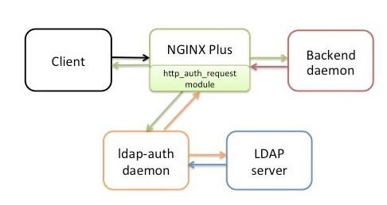
LDAP / AD Integration

Slide 28
Organizations & Teams
User accounts that exist within Docker EE, either through an LDAP sync or manually managed, can be organized into teams.
Teams need to be contained within an Organization.
Each team created can be granted a role on collections that will allow the members of the team to operate within the associated collection.

Slide 29
THANK YOU
Let us know how can we help your organization to Upskill the employees to stay updated in the ever-evolving IT Industry.
Get in touch:
www.zekeLabs.com | +91-8095465880 | info@zekeLabs.com
Visit : www.zekeLabs.com for more details

